Slide 1
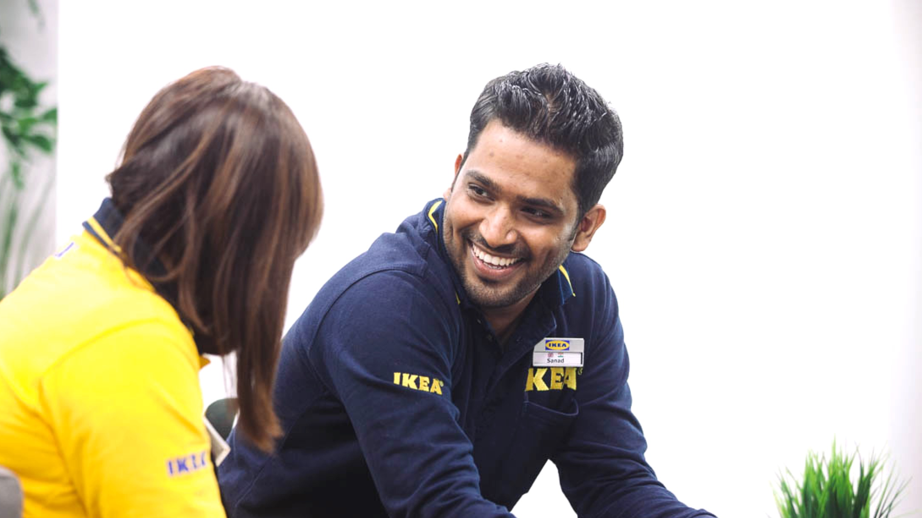



Growing Your people
Notes:
TRAINER’S NOTES
PURPOSE
These notes can help You with the pace & flow of the module.
Remember, it’s an espresso training session. Keep the train running; it can slow down for a bit but never stop.
Notes in “quotation marks” denote what You want to say to the audience. Feel free to paraphrase.
Notes without quotation marks are for Your eyes only. Instructions, background, tips & case studies (which You might use).
Good luck!
DURATION
Ninety minutes if You keep delegates focused.
ROOM AND SETUP
Ideally use a room with lots of natural light.
Set up the room café style: tables with four participants.
Play music at the start & during breaks. Music encourages people to talk.
Have flipcharts & new markers for each table.
STYLE
Fast-paced & practical.
Warmly greet people when they enter the room.
Use a parking lot for tricky questions. Announce it at the start. Chances are You won’t have to use it, but it can prevent long diversions.
Mix up participants for each exercise.
TIPS
Be in a good state of mind & well-rested.
When You are presenting, distribute Your weight equally on Your two feet. Don’t slouch.
Never talk for more than ten minutes without a pause or interaction.
Start at a brisk pace. You can’t make up for lost time later on.
Love Your audience:
Know the material so well that You can focus on the participants in the room.
Before You start each section, know what You want participants to learn, feel & do.
Keep to time. If You can’t, don’t blindly stick to Your slides. It hurts, but You may have to skip slides if time has slipped away.

Slide 2



Intense
Timed
Tasters
Notes:
“You know the drill: which has more caffeine an americano or an espresso?”
“So how do we keep time?”
If participants need prompting:
First of all, it’s INTENSE. Research shows that intense bursts of learning are just as effective as long training sessions.
The trade-off is that we will TIME activities so that we can deliver the course in the short time allotted. Remember, You will be learning just as much as if we spent all day discussing frameworks & research.
The activities are meant to be TASTERS. If You only manage to cover three questions out of eight, that’s fine. The exercises are meant to get You started. It’s vital to apply what You have learned right after the session, & we will support You.

Slide 3

How big is Your team?
How many people report to You?
How many people do You look after at work?
Notes:
"So, how can You grow Your people when You have lots on Your plate."
"Well, there are a few things You can do that don't take a great deal of time & that have a big pay-off."

Slide 4



v
v
v
Play to
strengths
Manage vital gaps
Grow careers
of A-players
Notes:
"So, how can You grow Your people when You have lots on Your plate."
"Well, there are a few things You can do that don't take a great deal of time & that have a big pay-off."

Slide 5
Agenda for today
Play to Strengths
Manage Vital Gaps
Grow Careers of A-players
Notes:
“Alongside achieving Your goals, growing Your people is arguably the biggest impact You can have as a manager.”
“It’s also highly satisfying.”
”We will cover three topics today.
Play to strengths
Manage vital gaps
Grow careers of A-Players”

Slide 6
v
Play to
strengths
Notes:
”Let’s start with playing to strengths.”

Slide 7

7
Think…..
about a time in Your life where You grew a lot. (Ideally at work but not necessarily)
What made You grow?
Notes:
Allow three to five minutes for this exercise.
“Take a moment to think about a time when You grew a lot. Ideally at work but not necessarily.”
Give participants 20 seconds to think & then ask for a few responses. You want the audience to recall the prominent influence great mentors & managers can have on people’s development.
“What made You grow?”
Two factors will likely come up, & You want to highlight these:
Challenged & taken out of their comfort zone.
Had a person who challenged & supported them. (Support is vital & sometimes neglected)
TRANSITION: “Notice, that You grew a lot at the time when someone (a manager) challenged You & forced You to grow in the area of Your hidden strength. In contrast, sometimes we get challenged but fail or find it unbearably hard because we are pushed in the area where we do not have a natural talent.”

Slide 8
You might have GROWN a lot at the time when someone (a manager) challenged You
& forced You to grow in the area of
Your hidden strength.
In contrast, sometimes we get challenged but
fail or find it unbearably hard because we are pushed in the area where we
do not have a natural talent.”

Slide 9

“A person can perform only from strength. One cannot build performance on weakness, let alone on something one cannot do at all.”
Peter Drucker
Austrian-American educator, author & management consultant
Most famous collection of books: CLASSIC DRUCKER
1909-2005
Notes:
Peter Drucker was a highly influential management consultant, educator, & author whose writings contributed to the philosophical & practical foundations of the modern business corporation. He is perhaps, the most influential management thinker of all time.
He lived 1909 to 2005.

Slide 10
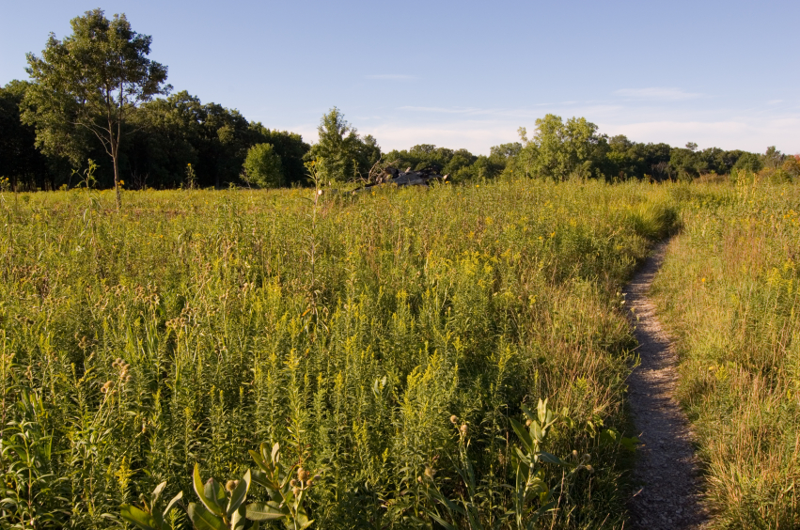

Non-talent
Talent
Notes:
“Why high performance can only be built on strengths? By the time we reach our early twenties, through a combination of nature & encouragement & support, some things come naturally, & others don’t.”
“For instance, some of us have an eye for detail, some don’t. Some like to work ahead of time, while others cope well under pressure.”
“We can grow much further & faster in our areas of natural talent.”
“When You work in the area of Your strengths, it’s like driving on a highway – You enjoy the process & it’s relatively easy. However, when we force ourselves to work in the area of our natural weakness, it feels like trying to drive on a dirt road. You can do it, but at a great cost to the car!”

Slide 11
5
THE
QUESTIONS
YOU NEED
Notes:
“I hear You thinking: how do I find out what the talents are of my people?”
“Like Sherlock Holmes solving a crime armed with only a few clues, here are five questions to reveal Your team’s talents.”
“Try it on yourself first. Take a few minutes to write down Your answers in the first page of Your handout.”
Participants should work on their own.

Slide 12
Talent clues
What activities do You naturally gravitate to at work?
What do You quickly learn that is faster than those around You?
What activities get You so engaged that You forget time?
What do You do exceptionally well (or what could You excel at with the right encouragement)?
What activities bring You feelings of pleasure & joy?

Slide 13
Play to people’s strengths
v
Don’t assume You know what Your people are good at – ask them!
Observe & coach Your people to do more of what they are good at.
Turn irritation into appreciation.
Play to
strengths
Notes:
"In summary,
Ask Your people where they think they can excel.
Help Your people do more of what comes naturally.
And appreciate & use Your people's strengths. We can overlook other people's strengths, especially when they aren't like our own."

Slide 14

Know what Your people are great at
Conduct an interview using the hand-out “Your strengths & preferences”.
Swap roles.
Share what impressed You the most about
the other person’s story.
Notes:
Allow ten minutes for the entire exercise.
Explain that You want participants to interview each other in pairs using the question on page two of their handouts.
Encourage people to swap roles after about four minutes. If most people haven't finished, give them an extra minute.
Before starting, point out that You want everybody to ask & answer the quick checklist questions at the end of the interview on page two.

Slide 15
Now…
What about gaps
that my people have?

Slide 16
v
v
Play to people’s
strengths
Manage vital gaps
Notes:
“You may ask: ‘What about gaps that my people have? Now let’s move on to managing vital gaps.”

Slide 17
Manage vital gaps
v
A non-talent only becomes a vital gap when it is critical to Your success
Manage vital gaps
Notes:
"Not every weakness is a critical one.”
"For example, a great accountant may not necessarily be highly adaptable or a fantastic presenter. These gaps aren't relevant.”
"However, if they don't know Excel, they are in trouble.”
"So, first, judge whether a person's weakness is critical."

Slide 18
Manage vital gaps
Think about a vital gap You have.
2. How do You manage it? What works? What doesn’t?
Notes:
Allow a few minutes for this exercise using page three of their handouts.
Participants should work on their own.
Ask a few people to share with the room what is & isn’t working well.

Slide 19




Manage vital gaps
Create a support tool/tactic
Knowledge?
Coach to compensate with a strength
A chance to learn
Analyse
Skill?
Work with a partner
Talent?
Adjust/change their role
Notes:
“If it’s a knowledge or skill gap help the person find a way to learn or gain exposure.”
“However, sometimes a critical weakness is down to lack of talent. Even with effort, it’s not something the person will do well.”
“You can help them with four strategies:
Create a support tool or a tactic.
Coach to compensate with a strength.
Work with a partner.
Adjust their role.”
Ask the room for examples or ideas for each strategy.
Have Your examples ready in case they get stuck but don’t provide answers too quickly.
The room must think through these strategies, so they understand them.

Slide 20
Manage vital gaps
v
Help to manage rather than fix vital gaps.
Reshape the role to fit the person rather than the other way around; small changes go a long way.
Encourage complementary partnerships.
Manage vital gaps
Notes:
Use these three points to summarise the section.

Slide 21
Manage vital gaps
Think about a vital gap that one of Your people has in their current role.
How have You managed the gap? What’s working? What isn’t?
What else could You do to help them?
Notes:
Allow five minutes for the exercise.
Ask delegates to interview each other using page two of their handout.

Slide 22
v
v
v
Play to strengths
Manage vital gaps
Grow careers
of A-players
Notes:
‘Finally, how You can grow Your best people.”
Ask the participants to use a blank sheet of paper. Demonstrate this activity on a flipchart:
“On the left hand side of the page, rank Your people according to their performance & potential.”
Once they have finished: “Now, on the right hand side, rank them according to the amount of TIME You spend with them.”
“Now, connect the same name with the straight lines. Do the lines look horizontal or diagonal? What do You think of that?”
Discuss the importance of spending more time with the A-players rather than with the weaker team members. By doing that You achieve two outcomes: a) You have both a ROI on Your team’s overall performance & b) You keep Your A-players by developing them.

Slide 23

Like a sharp jacket, careers should be made to measure.
Notes:
“Find out what suits you’re A-players’ ambitions & talents are & tailor their careers.”

Slide 24
Help Your A-players grow in their career
v
Encourage & take a chance.
Give people opportunities & stretch projects. Get them out of their comfort zone, especially in their areas of strength. Greater complexity, bigger remit, more critical work.
Grow careers
of A-players
Notes:
"Encourage & take a chance. Give people opportunities & stretch projects. Get them out of their comfort zone, especially in their areas of strength. Greater complexity, bigger remit, more critical work.
"Delegate. It's one of the most effective ways to give people new responsibilities & build their confidence. Remember that there is more than one way of getting things done; it doesn't have to be a mirror image of how You did it.”
"Make it OK to ask for help. Remove barriers & let the person know that it's OK to seek support from someone with complementary strengths.”
"Make it OK to fail. Don't overexpose people & encourage them to get back up & try again. Make sure the person learns from what went wrong."
”Get creative. It doesn't need to cost the world.” Development is wider than simply sending people on courses (next slide).”

Slide 25
Help Your A-players grow in their career
v
Delegate.
It's one of the most effective ways to give people new responsibilities & build their confidence. Remember that there is more than one way of getting things done; it doesn't have to be a mirror image of how You did it.
Grow careers
of A-players
Notes:
"Encourage & take a chance. Give people opportunities & stretch projects. Get them out of their comfort zone, especially in their areas of strength. Greater complexity, bigger remit, more critical work.
"Delegate. It's one of the most effective ways to give people new responsibilities & build their confidence. Remember that there is more than one way of getting things done; it doesn't have to be a mirror image of how You did it.”
"Make it OK to ask for help. Remove barriers & let the person know that it's OK to seek support from someone with complementary strengths.”
"Make it OK to fail. Don't overexpose people & encourage them to get back up & try again. Make sure the person learns from what went wrong."
”Get creative. It doesn't need to cost the world.” Development is wider than simply sending people on courses (next slide).”

Slide 26
Help Your A-players grow in their career
v
Make it OK to ask for help
Remove barriers & let the person know that it's OK to seek support from someone with complementary strengths.”
Grow careers
of A-players
Notes:
"Encourage & take a chance. Give people opportunities & stretch projects. Get them out of their comfort zone, especially in their areas of strength. Greater complexity, bigger remit, more critical work.
"Delegate. It's one of the most effective ways to give people new responsibilities & build their confidence. Remember that there is more than one way of getting things done; it doesn't have to be a mirror image of how You did it.”
"Make it OK to ask for help. Remove barriers & let the person know that it's OK to seek support from someone with complementary strengths.”
"Make it OK to fail. Don't overexpose people & encourage them to get back up & try again. Make sure the person learns from what went wrong."
”Get creative. It doesn't need to cost the world.” Development is wider than simply sending people on courses (next slide).”

Slide 27
Help Your A-players grow in their career
v
Make it OK to fail.
Don't overexpose people & encourage them to get back up & try again. Make sure the person learns from what went wrong.
Grow careers
of A-players
Notes:
"Encourage & take a chance. Give people opportunities & stretch projects. Get them out of their comfort zone, especially in their areas of strength. Greater complexity, bigger remit, more critical work.
"Delegate. It's one of the most effective ways to give people new responsibilities & build their confidence. Remember that there is more than one way of getting things done; it doesn't have to be a mirror image of how You did it.”
"Make it OK to ask for help. Remove barriers & let the person know that it's OK to seek support from someone with complementary strengths.”
"Make it OK to fail. Don't overexpose people & encourage them to get back up & try again. Make sure the person learns from what went wrong."
”Get creative. It doesn't need to cost the world.” Development is wider than simply sending people on courses (next slide).”

Slide 28
Help Your A-players grow in their career
v
Get creative!
It doesn't need to cost the world.
Development is wider than simply sending people on courses.
Grow careers
of A-players
Notes:
"Encourage & take a chance. Give people opportunities & stretch projects. Get them out of their comfort zone, especially in their areas of strength. Greater complexity, bigger remit, more critical work.
"Delegate. It's one of the most effective ways to give people new responsibilities & build their confidence. Remember that there is more than one way of getting things done; it doesn't have to be a mirror image of how You did it.”
"Make it OK to ask for help. Remove barriers & let the person know that it's OK to seek support from someone with complementary strengths.”
"Make it OK to fail. Don't overexpose people & encourage them to get back up & try again. Make sure the person learns from what went wrong."
”Get creative. It doesn't need to cost the world.” Development is wider than simply sending people on courses (next slide).”

Slide 29
Independent study
On the job coaching
Training &
e-learning
v
Give feedback
The many ways people grow.
Remember the
70-20-10 rule.
Buddy
up
Job rotations
Stretch
projects
Temporary assignments
Notes:
“There are many ways to develop people.”
Ask a few people to share examples of what has worked for them.

Slide 30

Who on Your team
is ripe for a new challenge?
Notes:
“Throw the ball in the air & see which team member grabs it.”

Slide 31

Become known as a leader who makes people’s careers
v
Promote the reputation of Your team.
Make it easy for members of Your team to work with people from other parts of the business.
Look for opportunities for Your people to take on projects in other parts of Al-Futtaim.
Grow careers of A-players
Notes:
“Be a like a Hollywood agent for Your people.”

Slide 32

Be known as a leader who tailors beautiful careers.
You’ll be a magnet for talent.
Notes:
“Don’t worry that if You develop people they may move on. You will develop a reputation of a great leader – talented people will want to work for You.”

Slide 33
Development goals
Use the questionnaire in Your guide - Your growth path.
At the end of the interview, agree a few developmental goals.
Take a minute to evaluate his/her development goals. Use the Developmental goals checklist.
Notes:
Participants should use pages four & five of their handouts.
“First, interview Your neighbor for 5 minutes.”
2) “After You have agreed a few development goals, take a minute & reflect on them individually from Your perspective as manager, using the Developmental goals checklist.”
3) Switch roles.
Do a quick debrief.

Slide 34
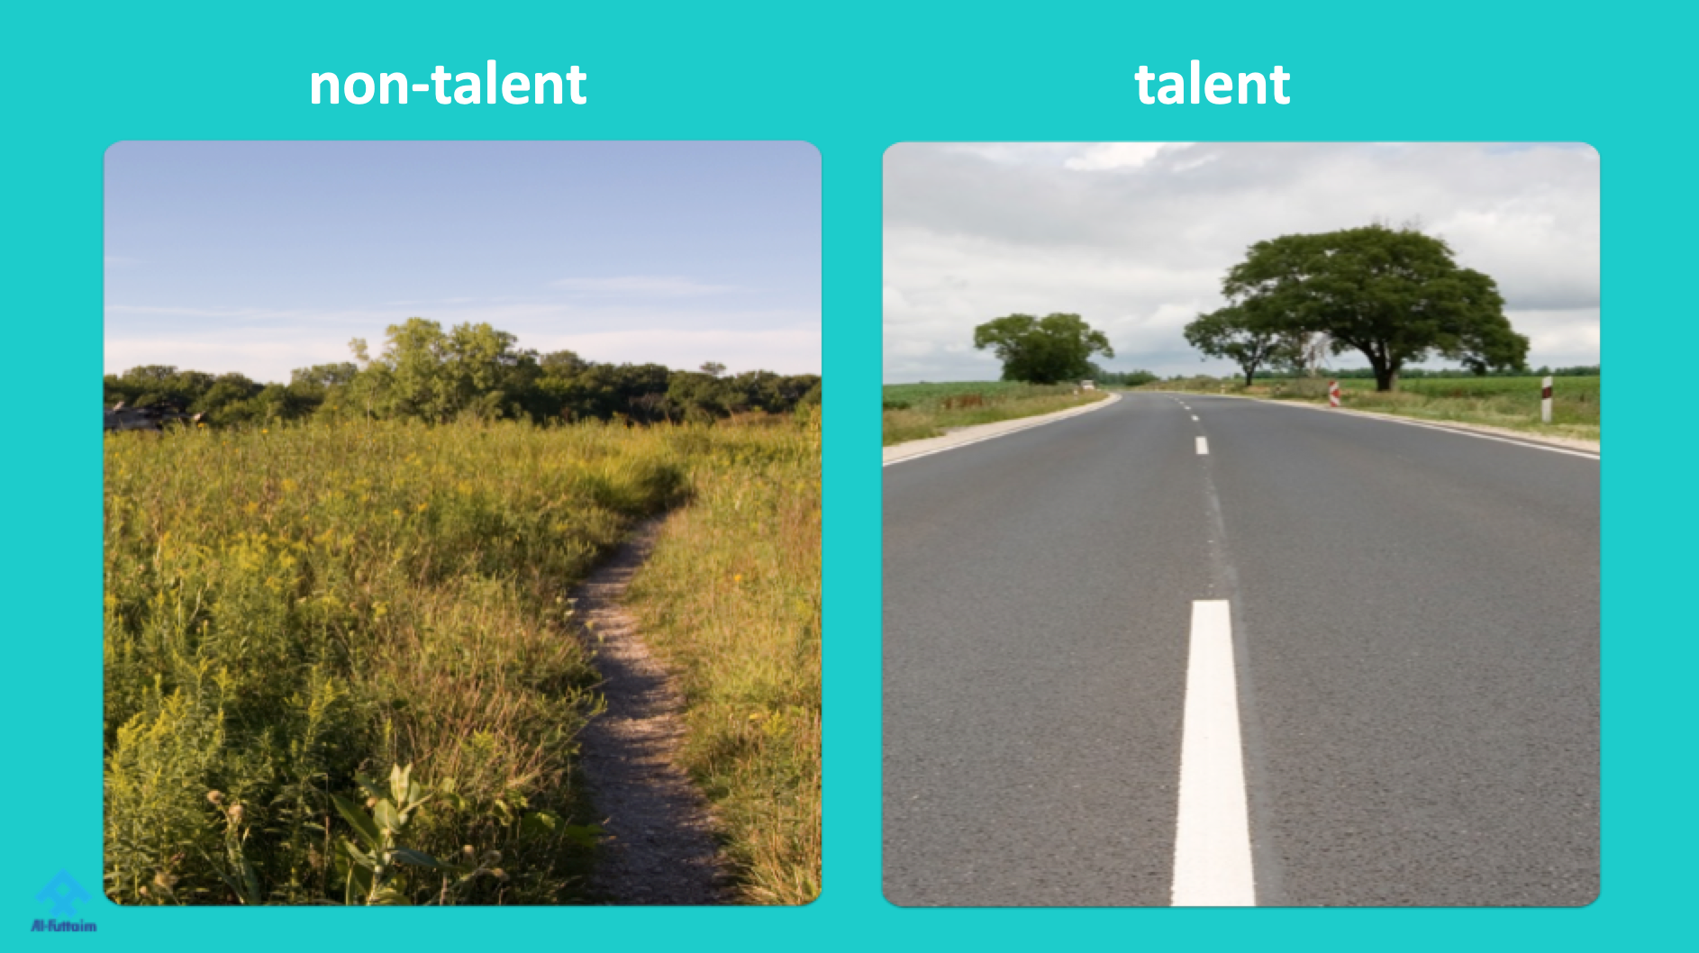
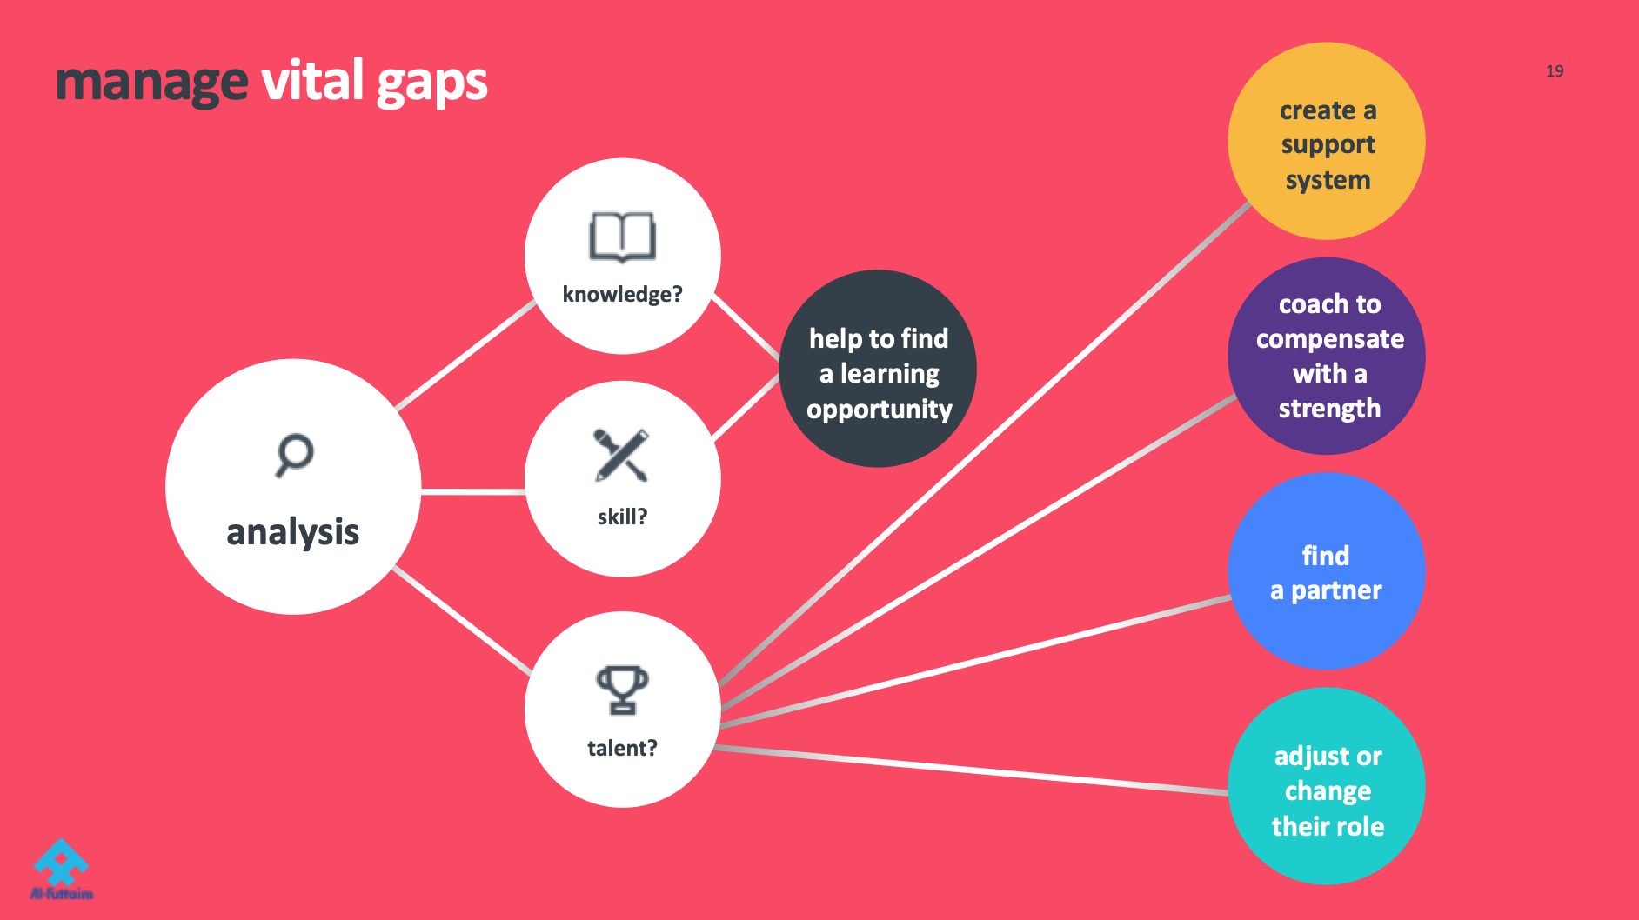


Summary of the module
Notes:
“If You have time, ask the room altogether to summarise each of the four slides briefly.”

Slide 35

Quiz Time

Slide 36
One-page summary
Notes:
“As ever, You will receive a one-page summary…

Slide 37
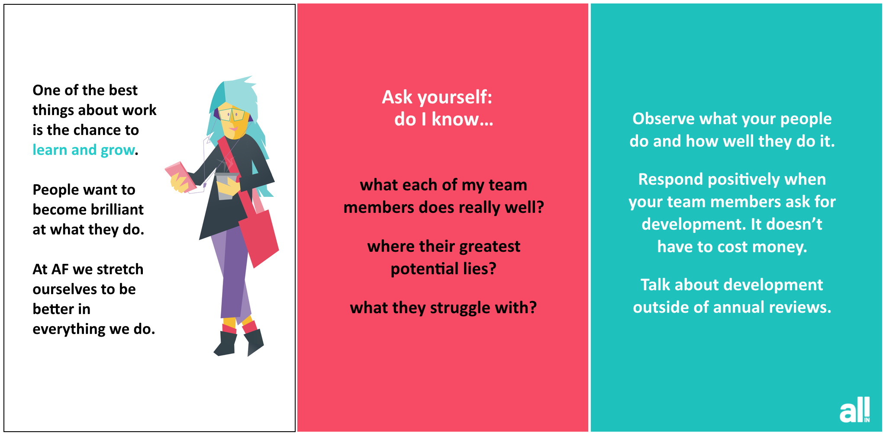
Weekly nudges
Notes:
…& eight weekly nudges to help You form a new habit. To grow Your people”

Slide 38
Closing comments
Notes:
"Before we finish, take a moment to think of Your closing comments. Let's go around the room & please share in about ten seconds what You are thinking right now."

